Slide 1

FelsenGroup OG
Agile, Precise, Above All: Stable

Slide 2
Agenda
Team Introduction
About The
Project
Project Timeline
Development
Milestones
Präsentationstitel

Slide 3

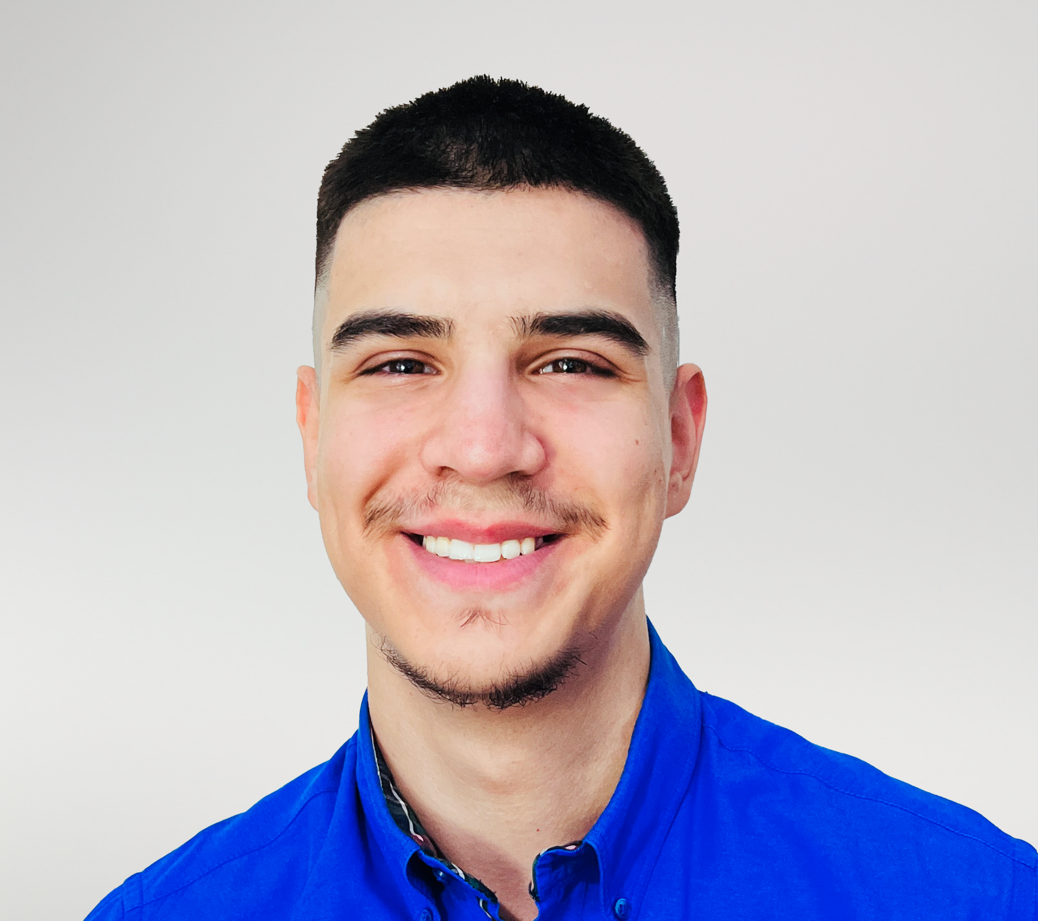
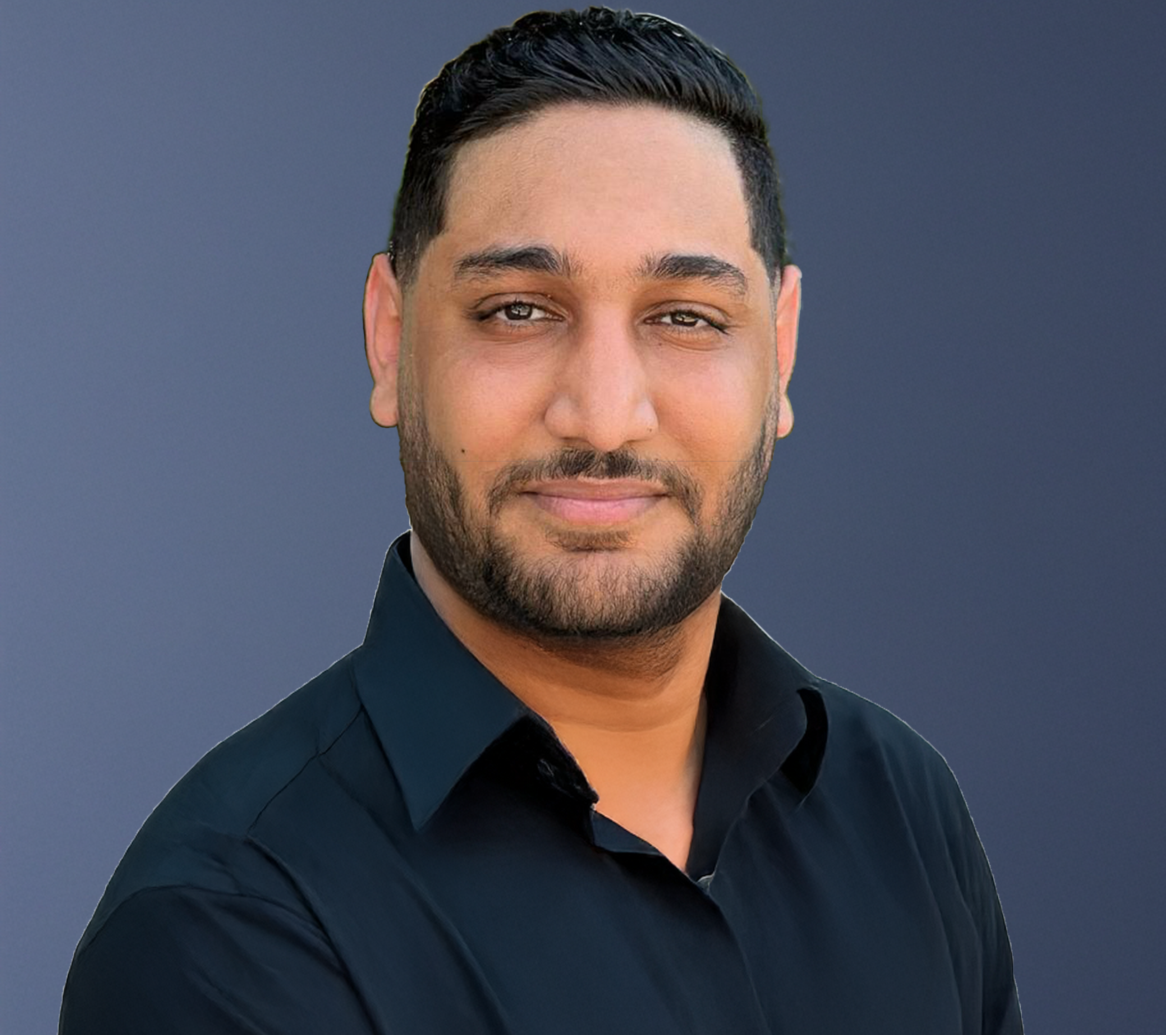
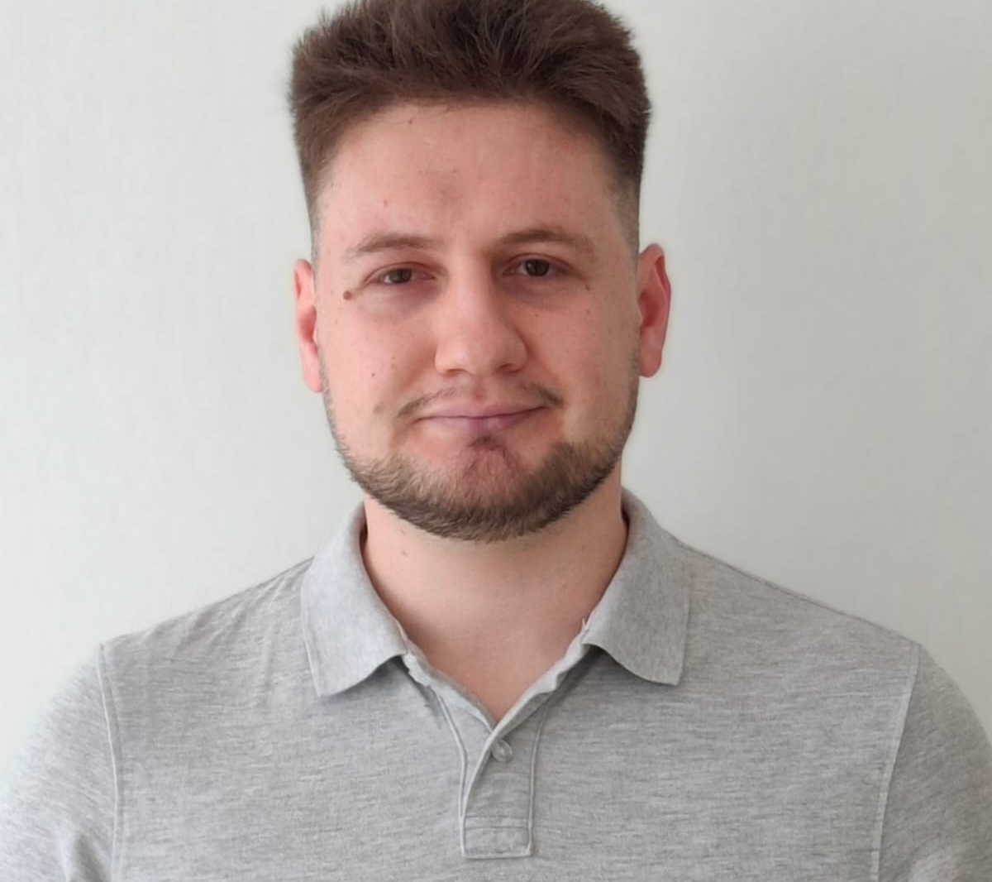
Meet our Team
Roland Loulengo
Mustafa Simsek
Alaa Farghally
Muhammed
Senior Backend Developer
Senior Frontend Developer
Senior Frontend Developer
Senior Backend Developer

Slide 4



Our Project
Find, Create and Edit Recipes
Create and Edit a Shopinglist
Overview of a Shoppinglist

Slide 5




Benefits of using Silverback Kitchen

Slide 6
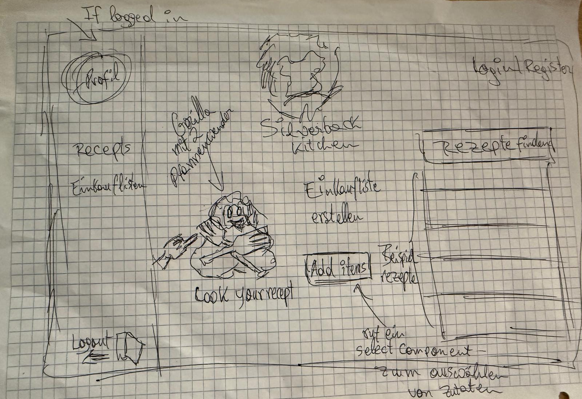
First Hand Sketch, Functionalities defined in SRS

Slide 7
Project Timeline
Planning
Design
Development
Testphase
Deployment
Team Assignment
Tool/Stack Selection
Work Packages
Milestones
Deadlines
Available Buffer
Hand-Drawn Sketches
Design Mockups and Wireframes
Database Design and Schema Draft
Database Implementation,
API Endpoints in Backend, Creating Frontend with React
Testing App locally, on various browsers, security testing, persistence, data integrity
Distribution to test users for UX reviews
on various devices: mobile, desktop and tablet

Slide 8
- Authentication, Authorization, Password Encryption - Session Management with Cookies and JWT - Creating REST API Endpoints - Database design, Environment setup, creation of tables - CRUD operations on resources against the Database - Testing CRUD operations using Postman client - Query Sanitization against SQL Injections - Logging System for Error Tracking - Hosting of Servers, Ensuring security with SSL
Backend Development

Slide 9
- Creating React Components, Styling with CSS - Responsiveness Crossplattform - Creating Assets, Icons, Images - Authentication handling at the Client Side - Requests against REST API Endpoints using Axios - Testing Features on Vite Dev Server - Unit Tests of Components, creating Tests with Jest - App hosting with SSL certificate
Frontend Development

Slide 10
Milestones
29. März. 2024
20. April. 2025
Final design of the UI
Deployment of the App
23. März. 2024
Local project created, remote collab is working, task allocation completed
14. April. 2025
17. April. 2025
Integration of Backend in Frontend
All MUST Criteria fulfilled

Slide 11




Thank you
+43 1 234 5678
contact@felsengroup.co
www.felsengroup.com

